Slide 1
Mobile Development with Xamarin
Mark Allan
Ranyart Systems
@MarkXA

Slide 2
Modern DNN
SPA modules – UI talking to web services
MVC APIs now a truly first class citizen
Since your module(s) now work through an API, building equivalent apps is an obvious next step

Slide 3
Modern DNN
Then
Now
DNN
SPA module
App
Traditional
DNN module
DNN
Module API
DNN API
DNN API
DB
DB

Slide 4
App per platform
Build a native iOS app
XCode, Objective-C / Swift, Storyboards / NIBs, Cocoa
Build a native Android app
Eclipse / Android Studio, Java, XML layouts
Build a native Windows app
Visual Studio, C#, XAML
OS X, Apple Watch, Google Wear, etc …

Slide 5
App per platform
iOS app
Android app
Windows app

Slide 6
Write once, run anywhere
Build app using HTML / CSS / JS
Framework provides controls and access to platform features
Cordova, Ionic, Kendo, Sencha
App emulates native UI on supported platforms

Slide 7
Write once, run anywhere
HTML5

Slide 8
Xamarin
Use preferred language
C# / F#
Write core logic once
Network calls, data model, business logic
Per-platform native UI
Native API access in preferred language

Slide 9
Xamarin
iOS UI
Android UI
Windows UI
C# / F# shared project
iOS C#/ F# platform code
Android C# / F# platform code
Windows C# / F# platform code

Slide 10
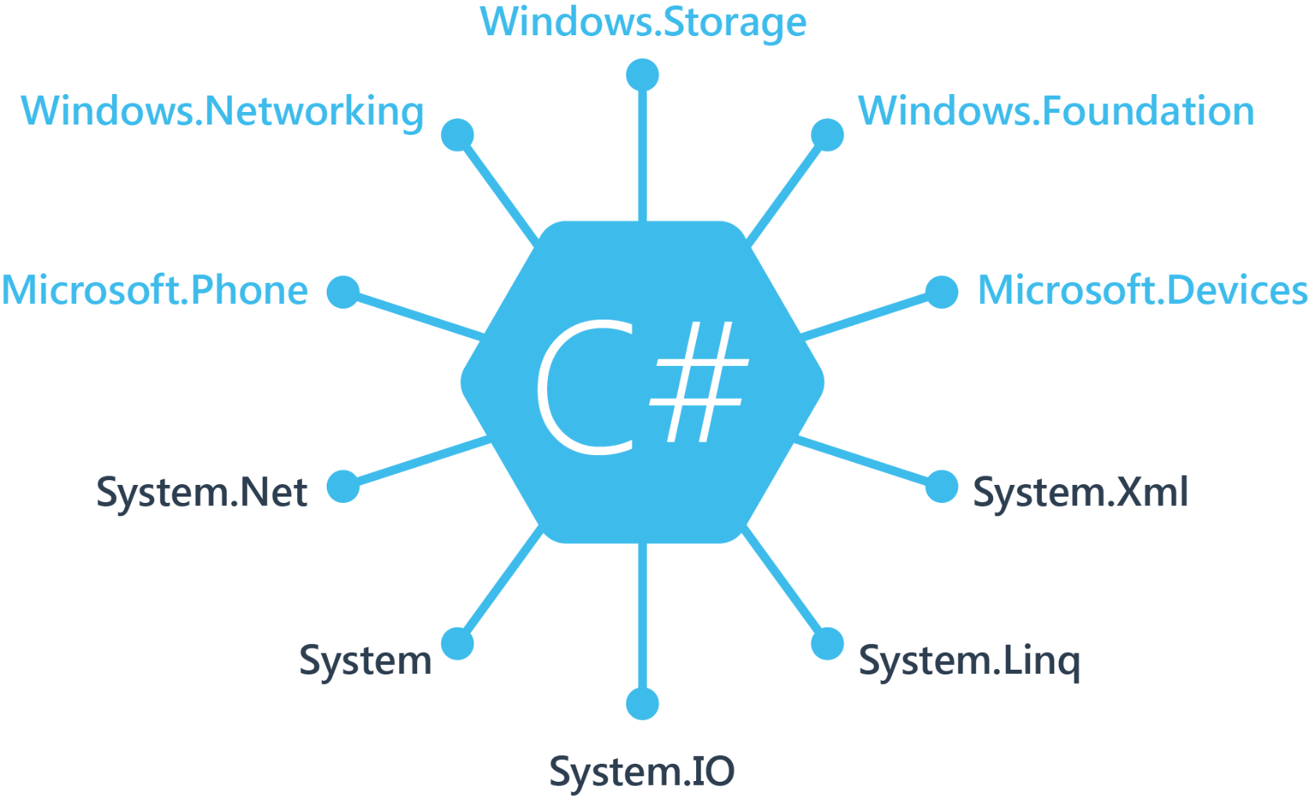
Windows APIs

Slide 11
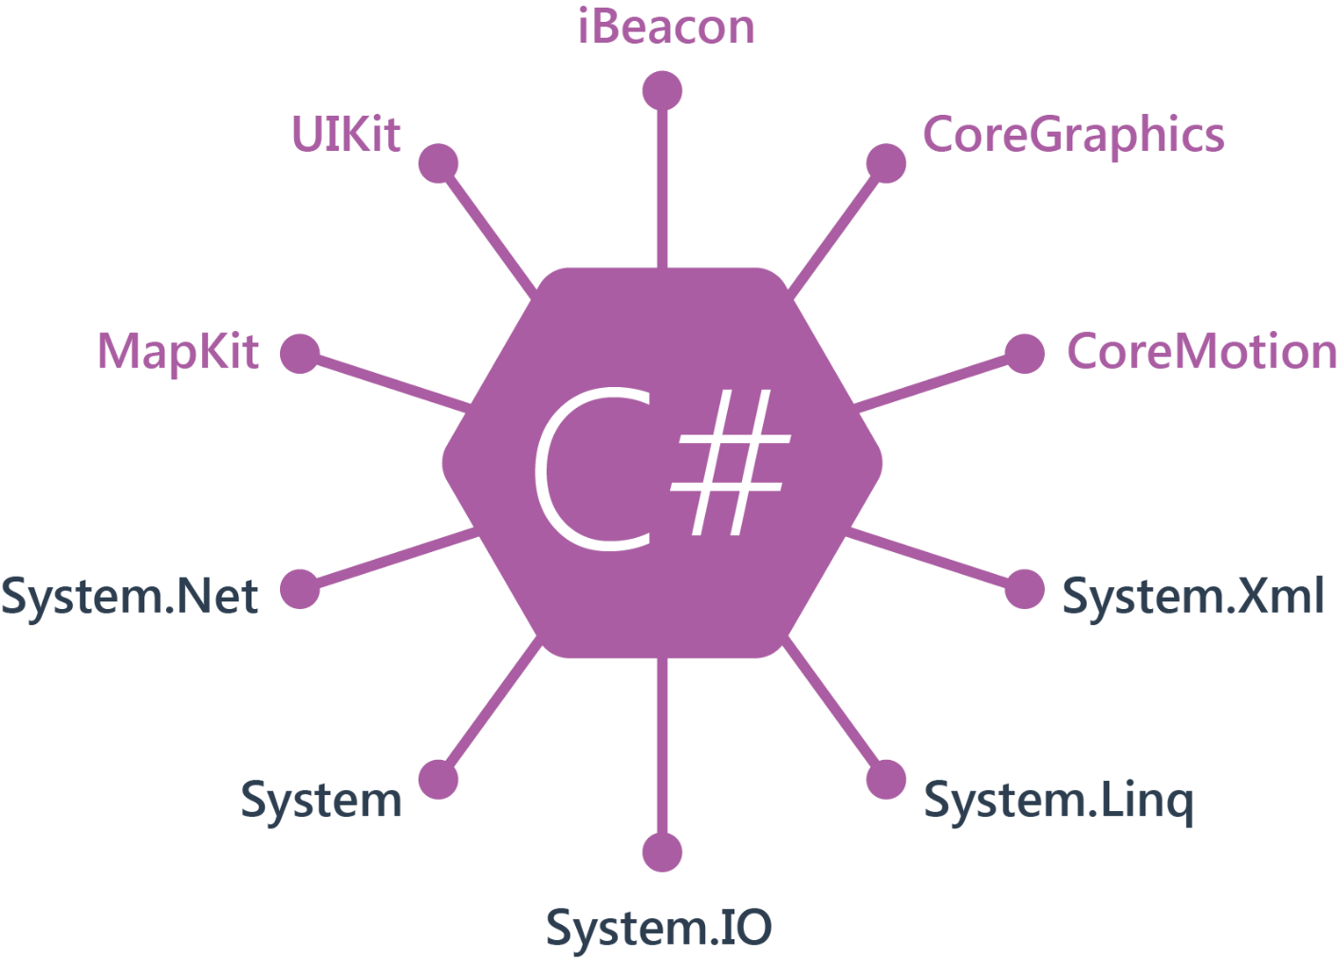
iOS APIs

Slide 12
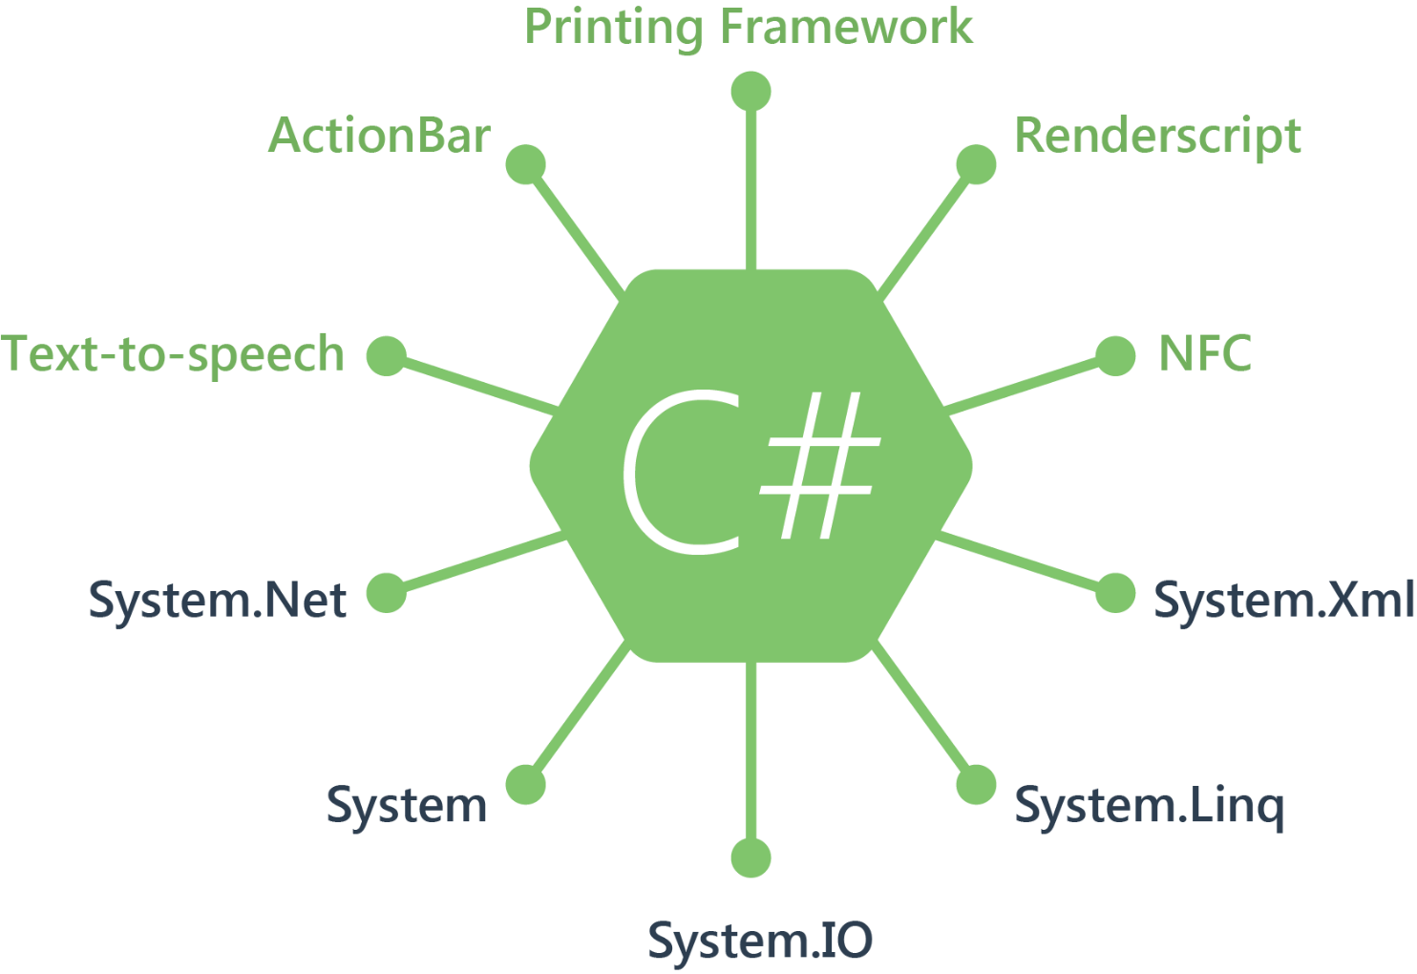
Android APIs

Slide 13
APIs
A native implementation of the .NET framework is provided for each platform
Platform APIs are exposed to C# / F# via .NET wrappers – 100% coverage
Anything you can do in Objective-C, Swift or Java can be done in C# / F#

Slide 14
Performance
iOS: Ahead-Of-Time compilation to ARM
Android: Just-In-Time bytecode compilation
Performance roughly equal to native
Using .NET and other cross-platform libraries may be slower than binding native libraries

Slide 15
Tools
Visual Studio
Run on Windows
Build and deploy to Android and Windows directly
Build and deploy to iOS and Mac via build host running on OS X machine
Xamarin Studio
Run on Windows or Mac
Extra support for iOS / Android apps
No support for iOS on Windows, or Windows apps on either OS

Slide 16
Code
Notes:
Walkthrough of contents of Xamarin’s Tasky sample solution (http://developer.xamarin.com/samples/mobile/Tasky/)

Slide 17
UI
iOS: Storyboards / NIBs (or raw code)
Android: XML layouts (or raw code)
Windows Phone: XAML (or raw code)
Platform-specific pages, controls, layouts

Slide 18
Xamarin.Forms
Use preferred language
C# / F#
Write core logic once
Network calls, data model, business logic
Single XAML UI generates native controls
Native API access in preferred language

Slide 19
Xamarin.Forms
XAML UI
C# / F# Portable Class Library
iOS C# / F# platform code
Android C# / F# platform code
Windows C# / F# platform code

Slide 20
Xamarin.Forms controls
Pages
ContentPage
NavigationPage
TabbedPage
MasterDetailPage
CarouselPage
Layouts
StackLayout
ScrollView
RelativeLayout
AbsoluteLayout
Grid
Controls
ActivityIndicator
BoxView
Button
Cell
DatePicker
Editor
Entry
Image
Label
ListView
OpenGLView
Picker
ProgressBar
SearchBar
Slider
Stepper
Switch
TableView
TimePicker
WebView

Slide 21
XAML example
<ListView
ItemsSource="{Binding MyList}"
IsGroupingEnabled="true"
GroupDisplayBinding="{Binding LongTitle}"
GroupShortNameBinding="{Binding Title}">
<ListView.ItemTemplate>
<DataTemplate>
<TextCell
Text="{Binding Name}"
Detail="{Binding Description}" />
</DataTemplate>
</ListView.ItemTemplate>
</ListView>

Slide 22
XAML output

Slide 23
Control extensibility
XAML custom control
iOS renderer
Android renderer
Windows renderer

Slide 24
Demo
Notes:
https://github.com/MarkXA/DNNConnect-Xamarin

Slide 25
Questions?

